Slide 1
CSE 211
Digital Design
Lab05 - Arduino Led Array, Analog In Out

Slide 2
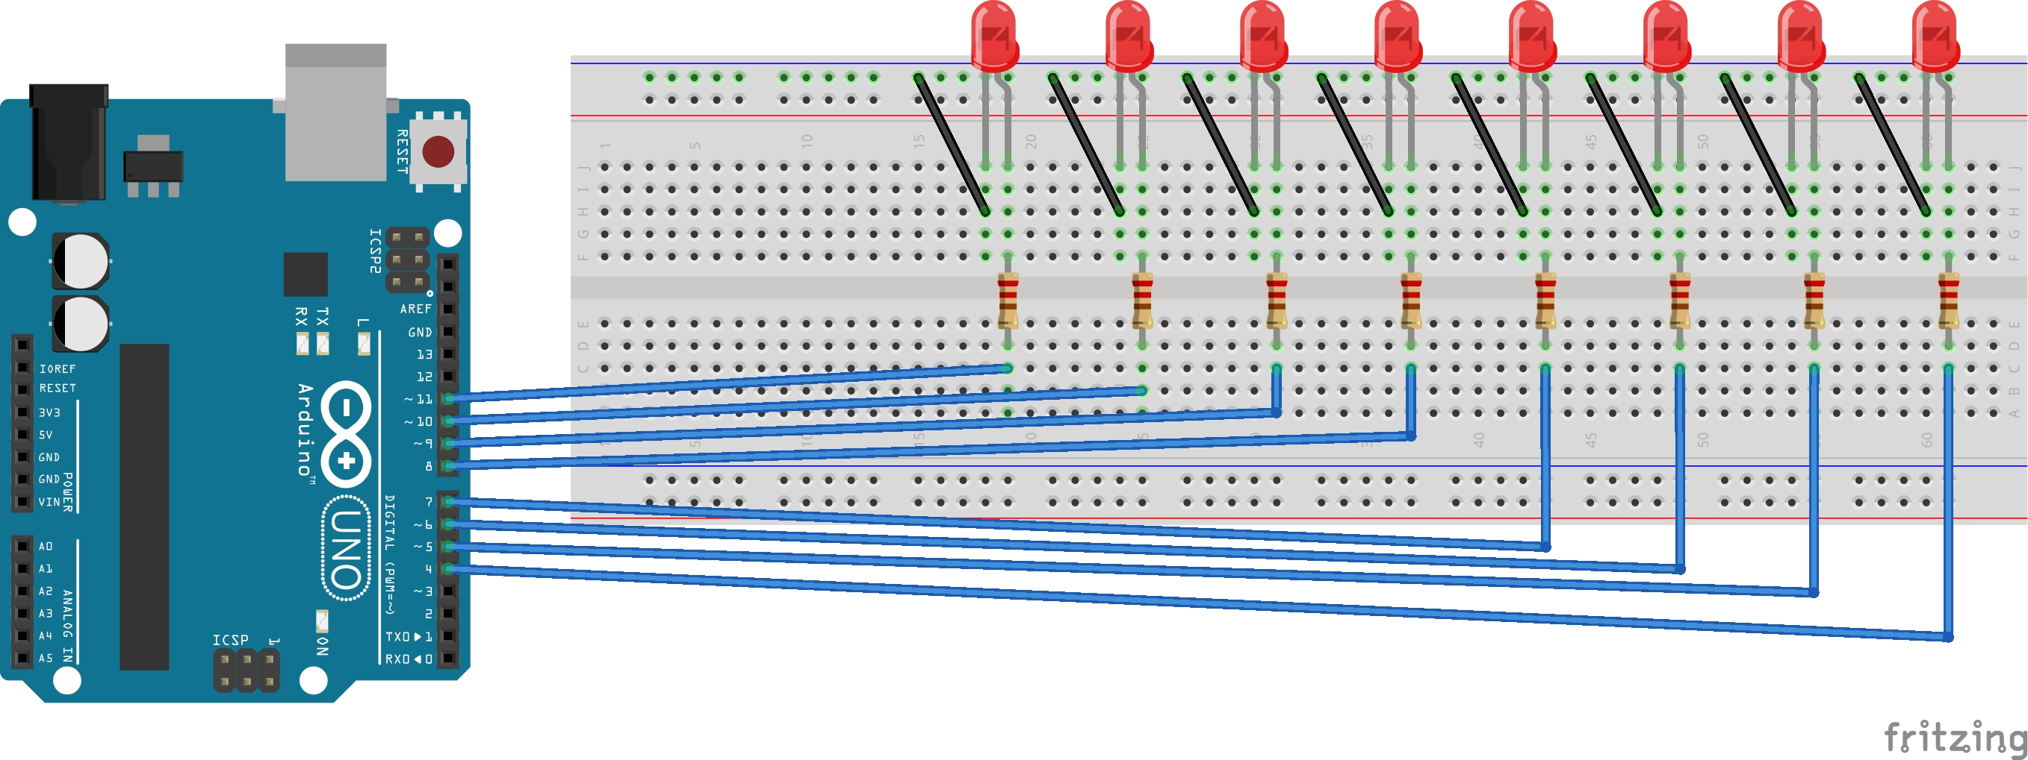
Ex. - Led Array
Tasks:
Connect 8 LEDs to Arduino.
Each LED will be on and off in order. First, from right to left then left to right. This action will be repeated forever.

Slide 3
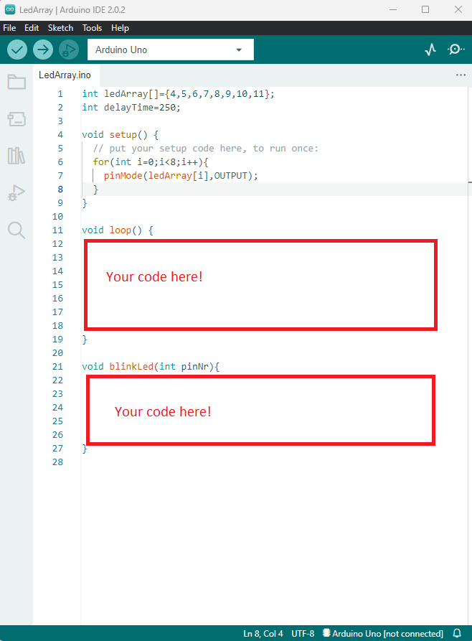
Ex. - Led Array
Tasks:
Connect 8 LEDs to Arduino.
Each LED will be on and off in order. First, from right to left then left to right. This action will be repeated forever.

Slide 4
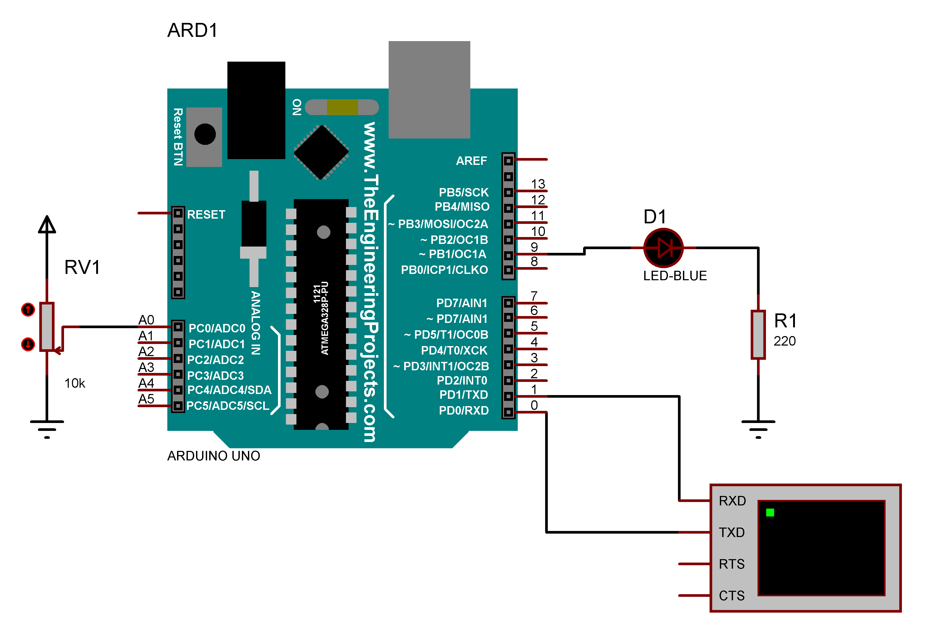
Ex. - Analog In Out
Tasks
Read analog value from potentiometer
Print the value with serial port monitor
Arrange the led intensity based on the analog value

